Slide 1

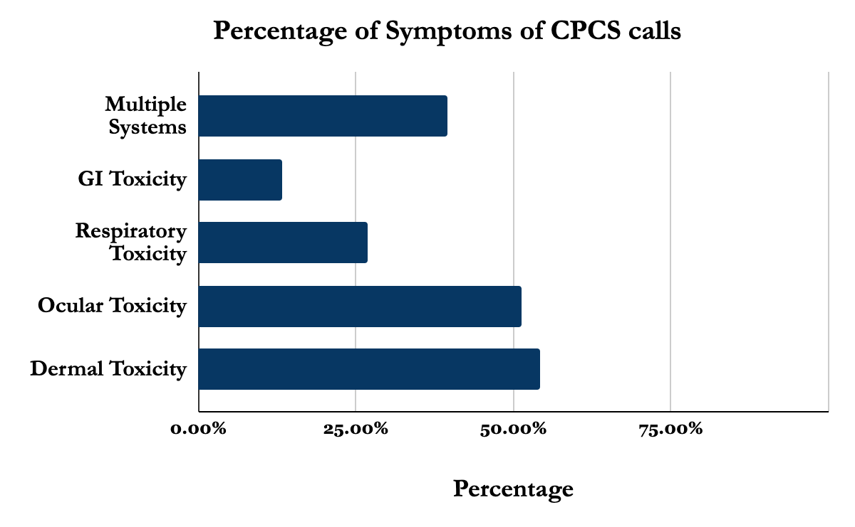


Pepper Spray and Tear Gas exposures reported to the California Poison Control System
Kevin Lieu, Timothy Albertson MD, MPH, PhD, Justin Lewis, PharmD, James A. Chenoweth, MD, MAS
University of California Davis School of Medicine, Department of Emergency Medicine
INTRODUCTION
RESULTS
CONCLUSIONS
Pepper spray and mace are common items used for personal protection and are common “less lethal” options for law enforcement use for crowd control.
These agents are irritants with symptoms of exposure ranging from mild pain to potentially permanent ocular injury.
The recent protests have increased attention on the use of these agents and their potential toxicity.
A total of 1,705 cases met criteria for inclusion. The most common exposures were to civilian self-defense sprays (N=1,139; 66.8%).
There were 60 reported exposures to law enforcement/military agents (3.5%).
Decontamination/irrigation was performed in 93.1% of cases.
The most reported symptom was dermal irritation (n=926; 54.3%).
Ocular irritation/injury occurred in 51.4%, airway symptoms occurred in 26.9%, and gastrointestinal symptoms occurred in 13.2%.
Most patients were treated at the site of exposure (1205 cases, 70.7%).
There was a trend towards exposures involving law enforcement/military agents requiring treatment at healthcare facility, but this did not reach statistical significance (OR 1.32, 95% CI 0.77-2.27, p=0.33).
When evaluating calls to the CPCS involving capsaicin-containing products and tear gas, the most reported symptoms were skin irritation and ocular irritation/injury.
Treatment was primarily supportive with irrigation/decontamination. Most exposures were mild and could be treated outside of healthcare facilities.
Exposure to law enforcement/military agents may be more likely to need treatment at a healthcare facility.
OBJECTIVES
Outcome | # of cases | Percentage
Treated on site | 1205 | 70.70%
Treated/Referred to HCF | 491 | 28.80%
Refused referral/AMA | 9 | 0.50%
To evaluate pepper spray and tear gas exposure calls to the California Poison Control System (CPCS).
METHODS
LIMITATIONS
All calls to the CPCS from November 1, 2015 to October 31, 2020 involving pepper spray and tear gas were reviewed.
Each case was evaluated for substance, symptoms reported, whether irrigation was performed, and if the patient was treated at or referred to a healthcare facility.
Logistic regression was used to evaluate differences in outcome between law enforcement/military agents and civilian agents.
Limitations of this study include a lack of long-term outcomes and potential reporting bias due to the nature of poison center data.
Further study of the long-term effects of these agents is needed to better inform potential policy changes regarding civilian and law-enforcement use.
 | Acute MI (n=888) | Difference | 30-day Composite (n=737) | Difference
HEART Score 0-3 | 98% (95%CI 89-100%) | -- | 94% (95%CI 86-98%) | --
ACS Pretest Probability <2% | 96% (95%CI 86-100%) | -- | 95% (95%CI 88-99%) | --
Troponin below LOD | 97% (95%CI 90-100%) | -- | 89% (95%CI 80-95%) | --
HEART Score 0-3 + Troponin below LOD | 100% (95%CI 93-100%) | 2% (95%CI -2 to 6%) | 100% (95%CI 95-100%) | 6% (95%CI 1-12%)
ACS Pretest Probability <2% + Troponin below LOD | 100% (95%CI 93-100%) | 4% (95% CI -1.5 to 10%) | 100% (95%CI 95-100%) | 5% (95%CI 0.2-10%)
 | Acute MI (n=888) | Difference | 30-day Composite (n=737) | Difference
HEART Score 0-3 | 98% (95%CI 89-100%) | -- | 94% (95%CI 86-98%) | --
ACS Pretest Probability <2% | 96% (95%CI 86-100%) | -- | 95% (95%CI 88-99%) | --
Troponin below LOD | 97% (95%CI 90-100%) | -- | 89% (95%CI 80-95%) | --
HEART Score 0-3 + Troponin below LOD | 100% (95%CI 93-100%) | 2% (95%CI -2 to 6%) | 100% (95%CI 95-100%) | 6% (95%CI 1-12%)
ACS Pretest Probability <2% + Troponin below LOD | 100% (95%CI 93-100%) | 4% (95% CI -1.5 to 10%) | 100% (95%CI 95-100%) | 5% (95%CI 0.2-10%)

